Slide 1
HOW TO FACE AN INTERVIEW
Compiled By: Shruti Gupta

Slide 2
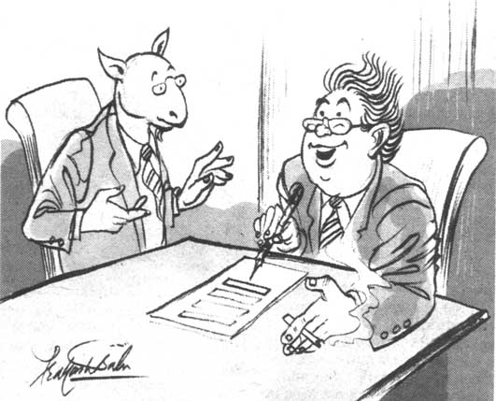

Slide 3
INTERVIEW
MEANING : A mutual view or sight
: Formal meeting
INTERVIEWEE : One who is interviewed
interviewer : One who interviews

Slide 4
INTERVIEW
AIMS OF THE INTERVIEW
To Elicit Information
To assess the suitability of a person to the job/position
To assess the job / position / Company by the interviewee

Slide 5
INTERVIEW
INTERVIEW IS NOT A ONE WAY PROCESS:
The interviewer is assessing the Interviewee for the suitability of the job or position
The interviewee is assessing whether the job is suitable to him with all related perks
Therefore, it is a two way process of communication.

Slide 6
Preparation is the key to success
Review own skills, experiences and qualities
Check CV
Anticipate questions and identify relevant examples
Prepare key selling points
Research organisation
Websites, reports, articles, company literature, etc
Contacts with knowledge of organisation or sector
Relevant articles in the press
Personal visit or telephone call
Research job and occupational area
Job description – or similar
Current issues
Prepare your questions

Slide 7
INTERVIEW
Rounds OF INTERVIEW:
Written tests/Trade tests
Group discussions
Verbal Interview

Slide 8
INTERVIEW
WRITTEN TESTS/TRADE TESTS
Test on subject
Test on general knowledge
Test on English usage
Numerical ability
Aptitude test (Like clerical, Stenography etc.)
Mechanical comprehension test (Aptitude)

Slide 9
INTERVIEW
GROUP DISCUSSION:
Initiative
Leadership
Dominant or submissive
Argumentative
Reasoning with others
Cohersiveness
Temperament
Expression

Slide 10
INTERVIEW
VERBAL INTERVIEW:
Family background
Communication Skill
General aptitude
Knowledge on subject
Personality
Potential to handle the job/to grow
Remuneration package

Slide 11
Types of Interview
Traditional Face-to-Face Interview The most traditional is a one-on-one conversation.
2. Panel/Committee Interview :there is more than one interviewer. Typically, three to ten members of a panel may conduct this part of the selection process. This is your chance to put your group management and group presentation skills on display.

Slide 12
Cont’d………..
3. Case Interview
In some interviews you may be asked to demonstrate your problem-solving skills.
The interviewer will outline a situation or provide you with a case study and ask you to formulate a plan that deals with the problem.

Slide 13
Cont’d…….
Telephone Interview: When candidates who live far away from the job site.
5. Group Interview : The goal of the group interview is to see how you interact with others and how you use your knowledge and reasoning to influence others.

Slide 14
Cont’d ..
6. Lunch/Dinner Interview : The setting may be more casual, but remember that it is a business meal and you are being watched carefully.
7. Stress Interview : The stress interview is usually a deliberate attempt to see how you handle yourself under pressure.

Slide 15
INTERVIEW
TIPS FOR INTERVIEWEE:
Collect the information well in advance about the Industry/Products/Culture etc. before appearing for interview
Be punctual for the interview
Present yourself neatly/Good mannered

Slide 16
INTERVIEW
Your hair should be clean and combed.
Nails should be clean and trimmed.
If the company does not have a dress code, remember that its better to overdress than under dress.

Slide 17
INTERVIEW
Arrive at least 10 minutes before your interview. The extra minutes will also give time to fill out any forms or applications that might be required.
Turn off your cell phone or pager.

Slide 18
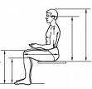
INTERVIEW
Sit relaxed and in up right position without crossing your legs
Beware of your forced habits - Breaking knuckles/Shaking your legs/Squeezing your palms/Wiping your face etc.,

Slide 19
INTERVIEW
When any drink is offered Say politely “No thanks”
Be bold and confident

Slide 20
INTERVIEW
Be polite and ask for queries in case of doubt while answering the questions
High light your strengths whenever a chance is given to you or create a chance to high light your strengths

Slide 21
INTERVIEW
Try to draw attention of the interviewer on specific subject you know well and try to take an opportunity to express them well
Mind your body language
Do not get frustrated or loose temper for some irritant questions posed

Slide 22
INTERVIEW
Do not have the negative feeling if you do not answer some questions
Do not try to bluff or cover your wrong answers
If you do not know the answer say I am sorry/ I am afraid I cannot answer the question etc.,

Slide 23
INTERVIEW
If you cannot understand the question ask politely to repeat the question
Do not give excuses of health for not answering.
Do not try to argue with the interviewer.

Slide 24
INTERVIEW
Have a good eye contact with the panel members of the interview
Wait for a question to be completed . Do not be hasty in answering even when you know the answer well

Slide 25
INTERVIEW
Do not take shelter under or blame the college or organization or lecturers for not answering some questions
Be clear in what you say - Do not mumble

Slide 26
INTERVIEW
Do not try to take sympathy by expressing your family problems / financial problems to the interviewer
At the end of interview, if you have still doubts on anything, ask for clarification from the interviewer

Slide 27
INTERVIEW
Do not accept or ask for whatever job the Company will offer (Say like, not related to your aptitude)
Do not plead or beg for
the job

Slide 28
INTERVIEW
Do not walk out of the interview in a huff. Wait until the interview is completed
After completing the interview, do not forget to wish or say thanks before you go out

Slide 29
Typical Questions
About you
Tell me about yourself - Bring me up to date with your CV?
Why did you choose that particular degree programme?
What experience have you had that is relevant to this post?
What would you consider your major achievements to date?
About the job
What interests you about this job?
What do you know about this organisation?
What other options are you considering?
How do you see your career developing – 5 years?
If you were Head of Department, what would be your priorities?
General knowledge
What do you think of the Government’s policy on college fees?
What’s your opinion about anna hazare?

Slide 30
Some HelpFul Sites
1. www.TimesJob.com
2. www.Naukari.com
3. www.FirstJob.com
4. www.FreshersWorld.com
5. www.SarkariNaukari.com

Slide 31
THANK YOU
ALL THE BEST

Slide 33
